Slide 1
Paper Review:
Clickbait Detection Using Long short-term memory
Authors: Aromal A Balan; Anoop P; AS Mahesh | Published in: 2022 Second International Conference on Interdisciplinary Cyber Physical Systems (ICPS) | Publisher: IEEE
Team No: 20
Members:
Saman Sarker Joy - 20101114 (Presenting)
Tanusree Das Aishi - 20101012
Naima Tahsin Nodi - 20101150
ST: Sadiul Arefin Rafi
RA: Md Sabbir Hossain

Slide 2
What the Research Paper is about?
As clickbaits are rising lately at an alarming rate mainly in social media sites, the paper puts emphasis on detecting this fishy titles which primary goal is to attract and encourage the visitors to click.
It presentes techniques to detect them employing deep learning algorithms mainly A RNN based model named LSTM. And what makes it unique is that it does it with account of the textual characteristics, word sequences and colloquial expressions.
They showed that their technique work pretty good with a high enough accuracy and does better than traditional machine learning model.

Slide 3
Dataset
They used a dataset containing 32,000 headlines in total and around 16,000 headlines each for both clickbait and non-clickbait.
Clickbait titles were collected from website like:
ViralNova, Upworthy, BuzzFeed, Scoopwhoop, ViralStories etc
Non-Clickbait titles are collected from:
Reliable sources like New York Times, WikiNews, The Guardian

Slide 4
Preprocessing and Word Embedding
The dataset was put through some preprocessing steps:
Converting all words into lowercase
Removed punctuations
Removed numbers
Removed stopwords (The, That, Is etc.)
Then they were converted into word vectors which is simply the Numerical representation of the words. For this paper, they used Word2vec word embeddings. This with the help of A NN model, it finds the word association which can find and identify synonyms and phrases used after its being trained.
The dataset was split into 80/20 percent for training and testing purposes.

Slide 5
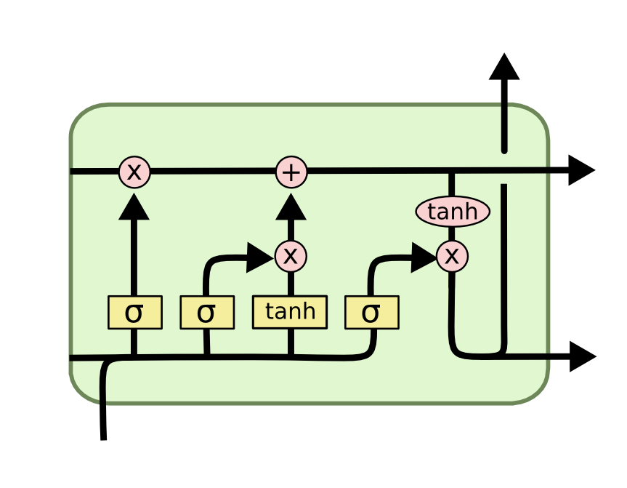
Models used in the paper
LSTM (Long Short-Term Memory) is a type of neural network that is good at understanding and making predictions with sequences of data, like sentences or time series.
Cell State: This is like a long-term memory that stores important information from the past. It helps the network understand the context of the sequence.
Input Gate: This gate decides what new information should be stored in the memory cell. It looks at the current input and the previous memory cell and decides what to keep.
Forget Gate: This gate decides what information should be forgotten from the memory cell. It looks at the current input and the previous memory cell and decides what to remove.
Output Gate: This gate decides what information from the memory cell should be used as the output of the LSTM unit. It looks at the current input, the previous memory cell, and the updated memory cell, and decides what to output.
Naive Bayes Classifier: The Naive Bayes classifier is a simple but effective algorithm used for classification tasks. It is based on Bayes' theorem, a fundamental principle in probability theory. The Naive Bayes classifier assumes that all features in the input data are independent of each other, meaning that the presence or absence of one feature does not affect the presence or absence of any other feature. This assumption simplifies the calculations and makes the algorithm computationally efficient.
Image 1: LSTM

Slide 6
Experiments and Results
Word2vec: Different dimension of word2vec was used from 50 to 300 and it was found that 200 was giving the best accuracy score.
For the LSTM: LSTM unit was set to 50, Dropout was 0.2, it ran for 3 epochs and Activation function was used sigmoid.
Results showed that:
 | Accuracy | Precision | Recall | F1
Naive Bayes | 0.94 | 0.94 | 0.94 | 0.95
LSTM | 0.96 | 0.96 | 0.96 | 0.96

Slide 7
Some Comments from my end
They used only one deep learning model for it.
They only used word2vec.
Experimenting with different hyperparameters gave a significant boost in the overall accuracy.
Preprocessing is very important in this kind of tasks.
Dropout value is used for reducing the change of overfitting.

Slide 8
Thank You.

